Slide 1
Learn 8051 Microcontroller with me.
Shriram K Vasudevan
Session 1
YouTube Channel: https://www.youtube.com/user/master4hereever
(You can search as Shriram Vasudevan as well)

Slide 2
Agenda
Architecture
Features
Family
Pinout
Registers and Organization – A complete understanding.
A and B registers
PSW
Register Bank and Stack (Memory Organization)
Stack Programming
8051 and peripherals (i.e. ports)
8051 and Timer
Magic Number – 11.0592
TCON and Counter Operations
8051 and interrupts.
RS 232 – Serial Communication

Slide 3
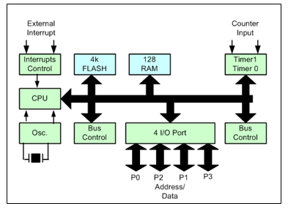
Architecture
8051 has got everything inbuilt, in fact that is the feature which distinguishes 8051 from a microprocessor.
Intel is the organization that came up with this idea of 8051 and it is a big hit.
Though Intel were the starting point of 8051, many other manufacturers are also permitted to make 8051 with same set of features and instruction set being compatible.

Slide 4
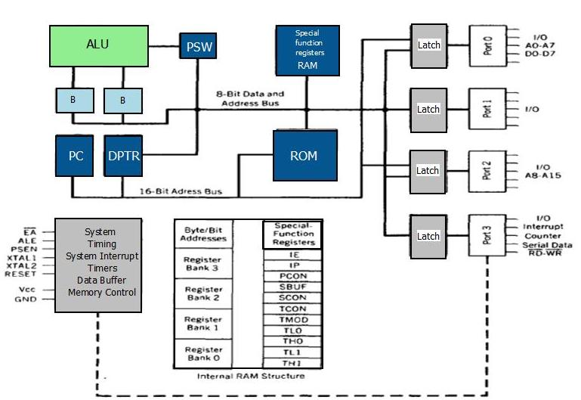
Features
8 bit microcontroller supporting 8 bit operations.
Much general purpose and few special function registers.
2 major 8 bit registers for arithmetical and other operations, A and B. A is accumulator and is bit addressable.
21 Special function registers, SFRs. They do lot of dedicated functions which makes life of programmers very easy.
Few registers are bit addressable and few are not.
Control registers for Timer, Serial communication and interrupts will fall under SFR category.

Slide 5
Contd.,
4 Register banks with having 8 registers in each bank.
4*8=32 registers can be used by the programmers. (Stack finds a slot there)
Stack pointer register
Points to the stack and it is an 8 bit register.
Data pointer, which is so called a 16 bit register, but it is a combination of two 8 bit registers, DPH and DPL.
16 bit program counter and no address for the same is allotted.
Program counter is a helper for the controller. It holds the address of the next instruction to be executed.

Slide 6
Contd.,
Eight bit program status word (PSW)
It is the flag register and it helps in selection of register banks as well.
Internal ROM or EPROM
Normally comes out with 4k ROM.
Internal user accessible RAM area of 128 bytes.
40 Pins package.
4 ports, P0, P1, P2 and P3 and they can be configured as input or output ports.
Two 16‑bit timer/counters: T0 and TI
Full duplex serial data receiver/transmitter: SBUF
Support for interrupt programming.
Oscillator and clock circuits.
Easier and simpler instruction set.

Slide 7
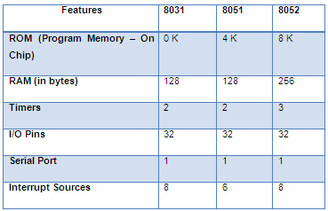
Family

Slide 8
Welcome to the world of 8051
Shriram K Vasudevan
Session 2

Slide 9
Agenda
Architecture
Features
Family
Pinout
Registers and Organization – A complete understanding.
A and B registers
PSW
Register Bank and Stack (Memory Organization)
Stack Programming
8051 and peripherals (i.e. ports)
8051 and Timer
Magic Number – 11.0592
TCON and Counter Operations
8051 and interrupts.
RS 232 – Serial Communication

Slide 10
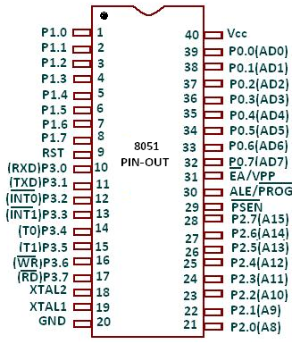
Pinout Details

Slide 11
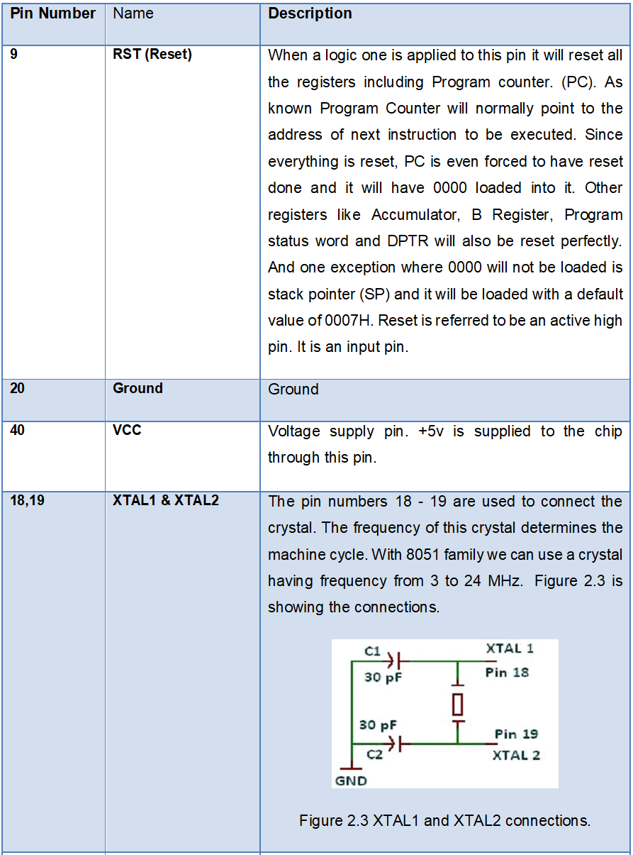
Contd.,

Slide 12
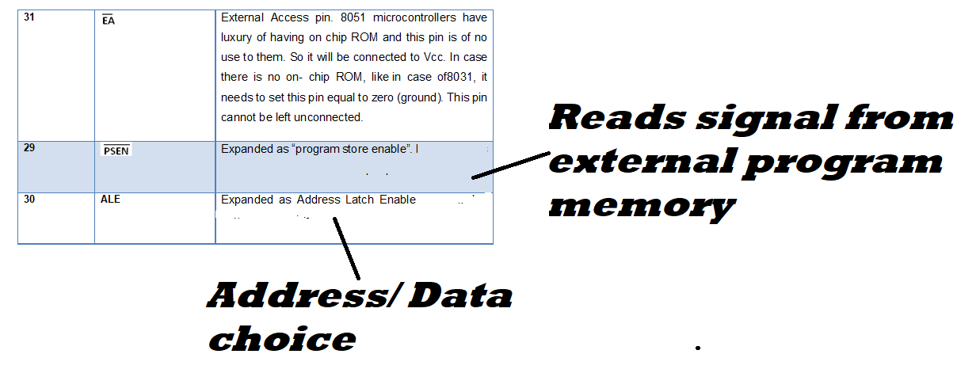
Contd.,

Slide 13
Welcome to the world of 8051
Shriram K Vasudevan
Session 3

Slide 14
Agenda
Architecture
Features
Family
Pinout
Registers and Organization – A complete understanding.
A and B registers
PSW
Register Bank and Stack (Memory Organization)
Stack Programming
8051 and peripherals (i.e. ports)
8051 and Timer
Magic Number – 11.0592
TCON and Counter Operations
8051 and interrupts.
RS 232 – Serial Communication

Slide 15
Register Organization
In 8051 almost all the registers are 8 bits wide.
Special Function Register (SFR) is the term used to denote the most important set of registers being used in 8051.
Let us first see the SFRs!!!

Slide 16
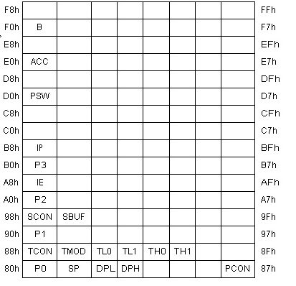
Special Function Registers
There are 21 special function registers available with 8051 microcontroller.
For an instance address of ACC is E0h and SBUF is 99h.
Some of these registers are bit wise accessible while some are byte addressable only.

Slide 17
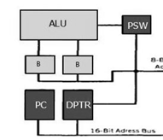
SFR – A Register (ACC)
This is one of the most important registers in the entirety.
Perhaps, without this one, 8051 is almost non usable.
It is an 8-bit register and is like heart of the microcontroller.
It is used in all mathematical and arithmetical operations. By default it would have 0 in all its bits. And it is bit addressable.
The importance of Accumulator A is because of the following reasons:
All the results obtained as a result of mathematical or arithmetical operations will be stored only in this register.
Operations like addition, subtraction, division and multiplication, one of the operands will have to sit in the accumulator A.
Many of the instructions that are being used will involve A. In short without A register 8051 is almost dead.

Slide 18
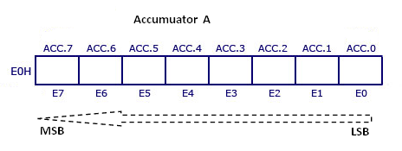
Contd.,
ACC.0 is the Least Significant Bit and ACC.7 is the Most Significant Bit.
And in the instruction, say MOV A,#06h (this instruction will be explained in instruction set at later.) it can be mentioned as A which will denote Accumulator or it can be mentioned as E0.
E0 is the address of the Accumulator.
There is one more special function register which is more or less equally important as A. It is B register.

Slide 19
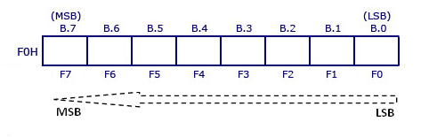
SFR – B Register
This is yet another register which is not negligible when the Multiplication or Division is done.
B must be one of the operands in the multiplication and division operations.
It is also an 8 bit register and can be accessed bit wise.
Addressed with F0.

Slide 20
An example with A and B registers
MOV A, R1; // Will move the content of R1 to Accumulator
MOV R5, A; // Will move the content of A to R5
MOV A, #10H; // # is a mark of data and not address. 10H will be moved to A
ADD A, #10H // same as previous, where 10H will be added with value present in A.
MOV A,#01H
MOV B, #02H
MUL AB // Usage of B register. Multiplication is not possible without A and B duo registers.
MOV A,#01H
MOV B, #02H
DIV AB // Usage of B register. Division is not possible without A and B duo registers.

Slide 21
Welcome to the world of 8051
Shriram K Vasudevan
Session 4

Slide 22
Agenda
Architecture
Features
Family
Pinout
Registers and Organization – A complete understanding.
A and B registers
PSW
Register Bank and Stack (Memory Organization)
Stack Programming
8051 and peripherals (i.e. ports)
8051 and Timer
Magic Number – 11.0592
TCON and Counter Operations
8051 and interrupts.
RS 232 – Serial Communication

Slide 23
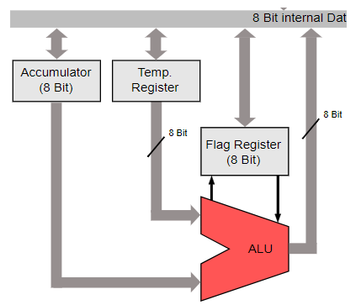
Program Status Word register (PSW)
It would be always better to keep an indicator for knowing if something is going wrong.
Microcontrollers have a provision for this and they are called FLAGS.
There are few flags which will help the user to know if the operations are happening as expected.
And all these flags are accommodated in a special function register called program status word.
It is bit accessible.

Slide 24
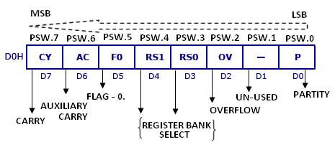
Contd.,
P – Parity flag –PSW.0 - it will be set or reset based on the value (numeric) present in the accumulator. If it has odd number of 1s then it is set and otherwise it is set to 0. So it serves just as an indicator.
PSW.1 – This field is not used and reserved for future usage.
OV – Overflow flag – PSW.2 – When result of a signed operation is very large, OV flag is used. It will be set in that case. Else will remain unset.

Slide 25
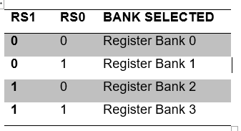
Contd.,
RS0 and RS1 – PSW.3 and PSW.4 – Register Bank Select. There are four register banks supported in 8051 and each of them has 8 registers from R0 to R7. The user has a flexibility of selecting one of those banks with using the register bank select options.

Slide 26
Contd.,
One important thing the programmer should remember. It is the clash between Stack memory and Register Bank -1.
Example instruction to get the register bank selected:
SETB PSW.X; where x can be used for selecting the bank.
i.e., SETB PSW.4; will get the register bank 2 selected.
By default the register bank 0 will be selected.
An example program:
Program 2.1
What are the instructions needed to select register bank 3?
SETB PSW.3
SETB PSW.4
Note: Both these instructions are needed

Slide 27
Contd.,
FO – PSW.5 – general purpose bit which can be used by programmer as per his wish.
Auxiliary Carry – PSW.6 – Used in the case of BCD related operations alone. And when there is a carry from D3 to D4 this will be set.
Carry – PSW.7 – As all other processors have 8051 has also got a carry flag. This will be used frequently by the processor for Arithmetic and shift operations.

Slide 28
SFRs – Few More.
TCON, TMOD, TL1, TL0, TH1, TH0 Special Function Registers.
These special function registers are all related to timer operations. We shall see this later when we discuss timer!
PO, P1, P2 and P3 Special Function Registers
All these are meant for accessing the available ports of 8051.
IP and IE Special Function Registers
These two plays a vital role in interrupt programming
PCON Special Function Register
Power consumption can be controlled with this register and this saves enormous power.
SCON and SBUF Special Function Register
SCON and SBUF helps in serial communications.

Slide 29
Contd.,
Data Pointer (DPH and DPL)
Data pointer register is imaginary one. It is actually nonexistent one. It is a combo of DPH and DPL registers. DPH and DPL are 8 bits each and can be combined together or can be used alone as well.
When a 16-bit data needs to be stored DPTR can be used as one register and the instructions are provided for the same. Few instructions are provided here for the reference of the reader.
MOV DPTR, #DATA; This will move the 16 bit date to DPTR.
INC DPTR; Increments the DPTR by 1.

Slide 30
Stack Pointer and PC SFRs
Stack Pointer (SP)
Every microcontroller or a processor will have a stack area for temporary storage purpose.
One can access the stack through the stack pointer. The stack pointer is an 8 bit register and it is referred to be as stack pointer register.
There are instructions related to stack and they are POP, PUSH and MOV SP, #XX. Where in the MOV SP, #XX, XX is the address where stack pointer should point to.
Program Counter (PC)
It is born special register. It has got no address.
The purpose of PC is to keep a paper mark. Simple, where should the control go next is the idea;
The address of next instruction to be executed will be kept in PC. It is one of the two 16 bit registers available in 8051. It makes job of the processor easier to navigate.

Slide 31
Welcome to the world of 8051
Shriram K Vasudevan
Session 5

Slide 32
Agenda
Architecture
Features
Family
Pinout
Registers and Organization – A complete understanding.
A and B registers
PSW
Register Bank and Stack (Memory Organization)
Stack Programming
8051 and peripherals (i.e. ports)
8051 and Timer
Magic Number – 11.0592
TCON and Counter Operations
8051 and interrupts.
RS 232 – Serial Communication

Slide 33
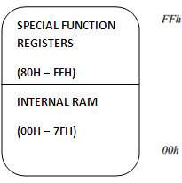
Register Bank and Stack
There are two broad categories and they are Program memory and data memory.
Program memory is normally referred to be ROM which is non volatile memory and read only in nature. It is used store
Boot up programs.
ISR (Interrupt service routines)
Macro functions
Data memory is useful in the case of storage of data temporarily, say during context switching. 8051 is organized so neatly with 256 bytes of memory and they are split as follows.
First 128 bytes: 00h to 1Fh Register Banks
20h to 2Fh Bit Addressable RAM
30 to 7Fh General Purpose RAM
Next 128 bytes: 80h to FFh Special Function Registers

Slide 34
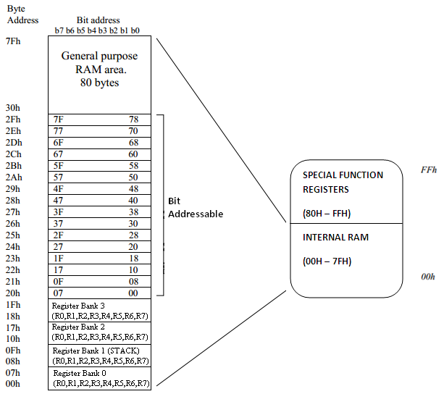
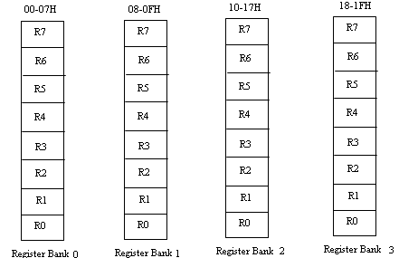
Contd.,
Taking the internal ram ranging from 00H-7FH (128bytes) , we proceed now.
There are 4 register banks as follows
Register bank 0
Register bank 1
Register bank 3
Register bank 4
With 8 registers each and the default bank is 0. If the programmer wants to navigate to different bank other than default it is possible with having PSW set accordingly.
Programmer should be very careful with one thing, Register bank 1 is not meant for general purpose usage. It is dedicated space for stack.

Slide 35
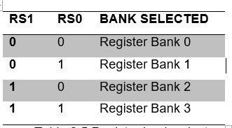
Register Bank Switching
This has been dealt already, but would be better to learn again. With PSW one can change the register bank. Default bank is register bank 0.
One important thing the programmer should remember. It is the clash between Stack memory and Register Bank -1. This clash will be discussed in detail in the area of stack memory. Example instruction to get the register bank selected:
SETB PSW.X; where x can be used for selecting the bank.
i.e., SETB PSW.4; will get the register bank 2 selected.

Slide 36
Bit addressable area
With this feature a programmer can set or clear individual memory bits in Internal RAM. There are 128 bits numbered 00h to 7Fh. SETB and CLR are available instructions to set or clear the bits.
Example :
SETB 07h ; sets the bit 07h (becomes 1)
General purpose RAM area
As the name mentions, it is meant for general purpose programming. Also when the stack space is not sufficient, programmer can move the stack pointer to general purpose area and can avoid congestion. One sample instruction is presented as follows.
MOV A, 6Bh; reads contents of address 6BH to accumulator

Slide 37
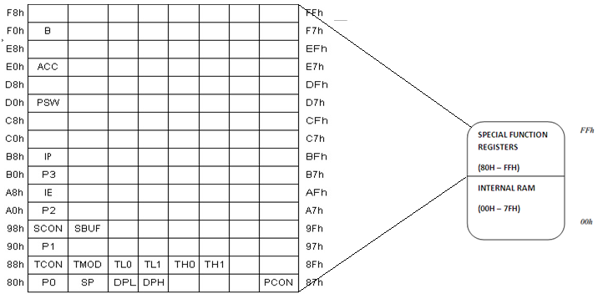
SFR and Memory

Slide 38
Welcome to the world of 8051
Shriram K Vasudevan
Session 6

Slide 39
Agenda
Architecture
Features
Family
Pinout
Registers and Organization – A complete understanding.
A and B registers
PSW
Register Bank and Stack (Memory Organization)
Stack Programming
Stack and RB1 clash
8051 and peripherals (i.e. ports)
8051 and Timer
Magic Number – 11.0592
TCON and Counter Operations
8051 and interrupts.
RS 232 – Serial Communication

Slide 40
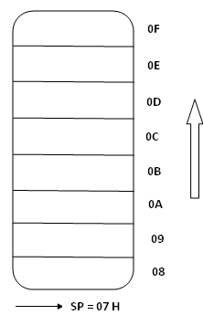
Stack Programming
Context Switching – Learn that!
Where is the stack located? how can it be used?
Register bank -1 is the area being utilized as stack and that is the reason that one should not select the register bank 1 for general purpose usage.
Stack starts from 08H and ends at 0FH. When the controller is switched on the stack pointer will be holding the value 07 which means the stack is starting from 08H.
PUSH and POP are the commands available with 8051 for loading the content into stack as well to move the content out of stack.
initially the stack pointer will be loaded with 07H which means that a PUSH will make it point to the first location 08H. Stack will grow upwards as shown in the figure with an arrow mark

Slide 41
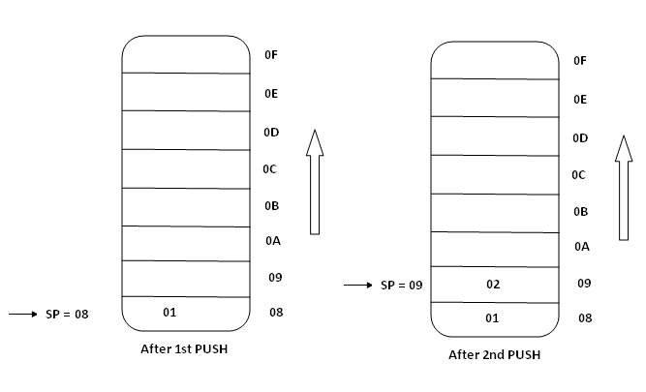
Contd.,
MOV R1, #01H; // Loading register R1 with 01.
MOV R2, #02H; // Loading register R1 with 02.
PUSH 1; // PUSHing onto the stack, content of R1 will be moved to 08. SP will now point to 08, i.e. incremented from 07 to 08H.
PUSH 2; // PUSHing onto the stack, content of R2 will be moved to 08. SP will now point to 08, i.e. incremented from 08 to 09H.

Slide 42
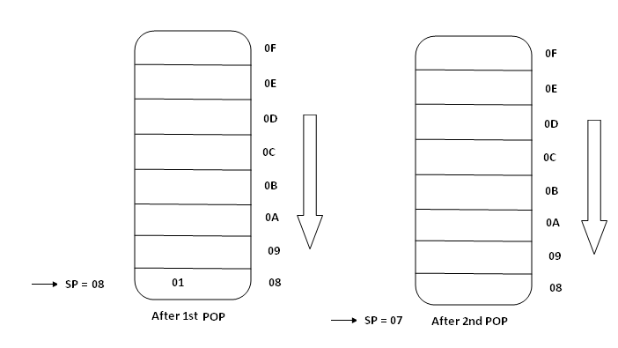
Contd.,
The following piece of code will be handy to understand POPing better.
POP 1; // Moves the content from top of the stack to Register 1. POP 1 is similar to POP R1
POP 2;// Moves the content from top of the stack to Register 2.

Slide 43
Stack and Register bank 1 clash
When there is need for PUSHING more than the available stack storage area, which is found to be very limited from 08H-0FH, Programmer will be in a mess.
Also it is very clearly noted that register bank-1 is the stack area.
If the programmer wishes to use the register bank -1 specifically, how can this be done?
Both have same answers.
Transfer the stack to a different area and use register bank-1 freely.

Slide 44
Contd.,
Where SP be moved? Simple.
The programmer can move the SP to point the general purpose RAM area available from 30 to 7FH.
Write a program in such a way that one can use register bank -1 freely. Make sure SP is moved to a different area.
With reference to figure 2.7 the code can be written easily.
MOV SP, # 61H; // Making SP to point 62H and it is the new stack area. Next to select the register bank with PSW.
SETB PSW.3; // Select the register bank-1.

Slide 45
Welcome to the world of 8051
Shriram K Vasudevan
Session 7

Slide 46
Agenda
Architecture
Features
Family
Pinout
Registers and Organization – A complete understanding.
A and B registers
PSW
Register Bank and Stack (Memory Organization)
Stack Programming
Stack and RB1 clash
8051 and peripherals (i.e. ports)
8051 and Timer
Magic Number – 11.0592
TCON and Counter Operations
8051 and interrupts.
RS 232 – Serial Communication

Slide 47
8051 and Ports.
As seen in the pin diagram 8051 has got 32 pins coming under the shed of 4 ports, P0, P1, P2 and P3.
Each of these ports have got 8 pins dedicated and can be configured as an input or an output port.
All the ports are by default on reset configured as output ports.

Slide 48
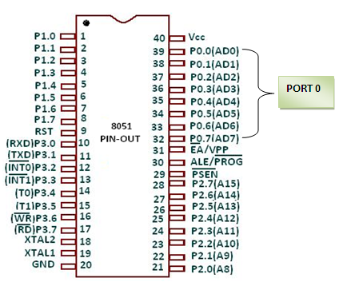
Port – 0
Port 0 is one of the most important ports which can perform dual role.
So, it is as good as having 8 more pins in the chip.
With just 8 pins, it provides the facility of 16 pins which is really awesome and it reduces discomfort.
In short it increases the versatility.

Slide 49
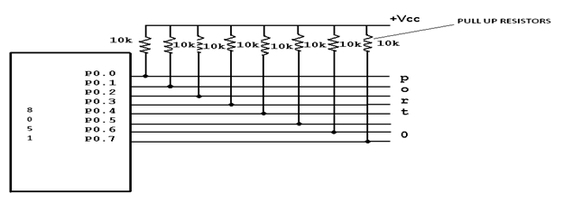
Contd.,
As all other ports, port 0 has got 8 pins and it starts from 32 and ends at 39.
It can be configured as input or output port based on the requirement.
A 10KΩ pull up resistor is required for each of the pins from port-0 as they are open drain configuration where it is not the case with other three ports. (Enables to get amplified voltage range)
For making the port 0 as an input port it should be fed with 1^{s} .
Then it will be set as input port.

Slide 50
Contd.,
Configuration of port-0 as input port:
MOV A, #0FFH;
// Storing all 1s in accumulator so that it can be moved to port 0, which set it as an input port
MOV P0, A;
// All done. It is an input port now.
And to keep it further simpler, above two lines can be re-written as,
MOV P0, #0FFH // this itself configure the port as input.
Reset will get the ports set as output port:
MOV A, #00H; // Storing some data in accumulator so that it can be move to port 0, which set it as an output port after reset.
MOV P0, A // 10H is moved to P0 which is an output port now.
And here too, the task can be made simple with the following one liner,
MOV P0, #00H; // Simple and powerful.

Slide 51
Port -0 - An additional responsibility.
Unlike port-1, where they do only one specific function of being an input or an output port, Port-0 does much more.
It has one more vital task to do.
What is it meant for? When 8051 chip is connected to external memory, port 0 will facilitate with address and data.
With the ALE someone can find out if it is data or address.
If address, ALE will be set to1 and if data, it will be set to 0.
And, if data it will be seen as D0 to D7 and if address it will be seen as A0 to A7.
Having known the importance and usage of port 0 one can now move on to the next port, Port -1.

Slide 52
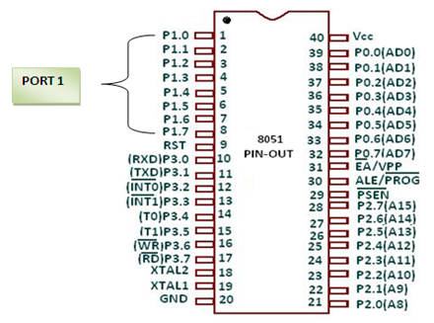
Port – 1
Configuration of port-1 as input port:
MOV A, #0FFH; // Storing all 1s in accumulator so that it can be move to port 0, which set it as an input port
MOV P1, A // All done. It is an input port now.
And to keep it further simpler, above two lines can be re-written as,
MOV P1, #0FFH // this itself configure the port as input.
Configuration of port-1 as an output port:
Simple, Reset will get the ports set as output ports.
MOV A, #00H; // Storing some data in accumulator so that it can be move to port 0, which set it as an output port after reset.
MOV P1, A // 10H is moved to P0 which is an output port now.
And here too, the task can be made simple with the following one liner,
MOV P1, #00H; // Simple and powerful.
It has the same number of pins as other ports do.
It is having 8 pins and it can be configured as input or output port based on the programming necessity.
And, it has a simple setup and it does not need any pull up resistor as it did with port 0.
It has got inbuilt pull up resistors. When someone wants to use this port as an output port, the job goes easier. Just with a reset the port gets configured as output port.
And again when it has to be used as input port, similar idea as port -0 needs to be followed.
Loading 1 to all the bits of P1 will make it an input port.

Slide 53
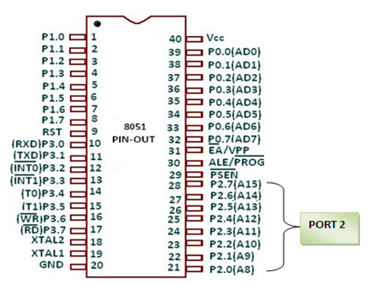
Port – 2
It can also be configured as input or output port based on requirement.
It does not require any pull up resistor.
The port can be configured in the same way as other two ports did.
It can be loaded with 1 in all the bits of port to get it set as input port and loading it with 0s or resetting it will configure the port as output port.
Code same as previous one!
Port -2 - An additional responsibility.
If it is 8051, then it will be used as input and output ports. But in the event of 8031, P0 will be used with P2 which offers 16 bit address. P0 has A0-A7 whereas P2 has A8- A15 providing the 16 bit address.

Slide 54
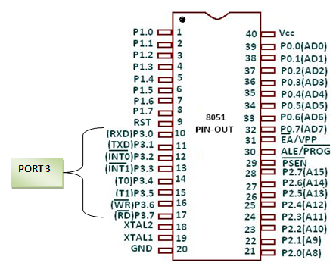
Port – 3
Port-3 has got 8 pins as others and it will be very handy with the functions it offers.
It can also be configured as input or output port based on requirement.
Similar to Port – 1 and it does not require any pull up resistor.
The port can be configured in the same way as other two ports did.
It can be loaded with 1 in all the bits of port to get it set as input port and loading it with 0s or resetting it will configure the port as output port.
It can be seen that it has tags as INT, RXD, TXD, T0 and so on.
So, it reveals the fact that port – 3 plays a vital role in interfacing, interrupts and timers.

Slide 55
Are the ports bit accessible?
Yes. Very much they are bit accessible and any port’s bit can be accessed. An example program will be witty here.
SETB P2.2; // will set P2.2 as an input port. Instead of setting the complete port as input port, one of the bits of the port is set as an input port here.
CLR P2.2;// will clear the bit P2.2 and instead of setting the complete port as output port, one of the bits of the port is set as an output port here.
Program: Write a program to set and reset bit 3 of port -1 continuously.
DO_AGAIN: SETB P1.3 // setting p1.3, i.e. input port
ACALL DELAY // calling a delay loop
CLR P1.3 // resetting p1.3, i.e. output port
ACALL DELAY // calling a delay loop
SJMP DO_AGAIN // program will be run continuously.
DELAY: //Some delay routine here. You can write any piece of code here. But proper delay programming with timer is taught in the next discussion on timers.

Slide 56
Welcome to the world of 8051
Shriram K Vasudevan
Session 8

Slide 57
Agenda
Architecture
Features
Family
Pinout
Registers and Organization – A complete understanding.
A and B registers
PSW
Register Bank and Stack (Memory Organization)
Stack Programming
Stack and RB1 clash
8051 and peripherals (i.e. ports)
8051 and Timer
Magic Number – 11.0592
TCON and Counter Operations
8051 and interrupts.
RS 232 – Serial Communication

Slide 58
8051 and timer
8051 has got two inbuilt timers Timer 0 and Timer 1.
They are 16 bit wide.
Since only 8 bits are supported, these 16 bit timers are split to two 8 bit registers.
Before jumping to the operation of the timer one must mandatorily know the use of TMOD register, which is expanded as TIMER MODE REGISTER.
Timer 0 is split as TL0 and TH0 which correspond to lower byte and upper byte respectively.
Same is the story for Timer 1 where it is TL1 and TH1.

Slide 59
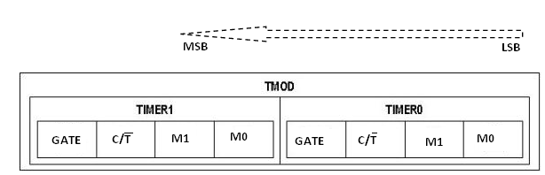
TMOD register
This special function register is like spinal cord of Timer operations.
Without this timer mode register nothing great would be performed.
Because of its high importance it is available for both the timers Timer 0 and Timer 1.
TMOD is split and assigned equally with Timer 1 and Timer 0.

Slide 60
Contd.,
GATE This holds the key functionality.
A timer needs to be started for it start functioning. How can it be started? Simple, Go with instruction set or use external hardware.
The preference goes with the programmer.
Well, there is where GATE plays the role.
When the programmer feels that instruction set is sufficient, then SETB and CLR instructions can be used.
SETB TR0, SETB TR1 will set the timers. CLR TR0, CLR TR1 will stop the timers.
But, the software way of setting or stopping requires GATE to be set to 0.
GATE serves as an indication for if external hardware is used for timer start/stop actions.
When GATE is set to 1, it means some external source will be used for starting the timers.
When hardware way of starting/stopping is used, INTx pins will come into play.

Slide 61
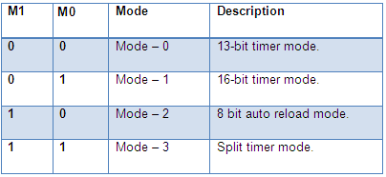
Contd.,
C/T (Counter/Timer) It is the selection bit which will help programmer in selection of timer or counter operation based on requirement. When set to 1, it will be a counter. Else it will act as timer.
Mode select bits M1 and M0 are called as mode select bits and they are useful for selection of timer modes. Timer in 8051 can operate in 4 different modes

Slide 62
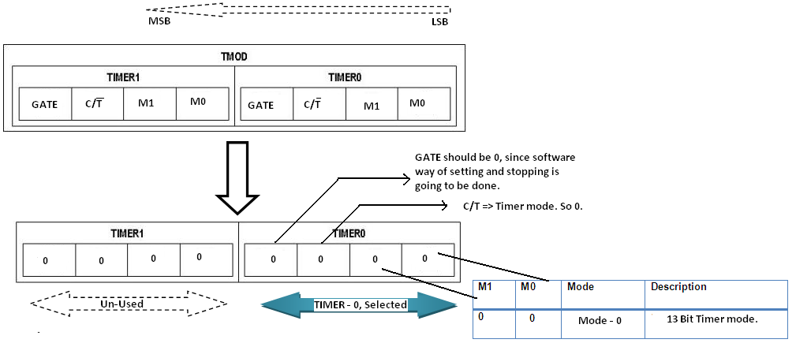
MODE – 0 (13 bit timer)
Mode 0 – 13 bit timer mode
It is 13-bit timer mode and can clutch values from 0000H to 1FFFH (Range for 13 bits, will be FFFF for 16 bits).
A 13-bit value can be loaded into TH and TL registers.
Once the timer touches the 1FFF, it will roll to 0000H and will set the Timer flag from TCON register.
Step: 1 Select timer and timer mode with having TMOD register. Instruction meant for the purpose is MOV TMOD, #00H.
// selects timer mode -0 for Timer 0.
What next? The count. Some count that needs to be loaded has to be loaded into TL0 and TH0.

Slide 63
Contd.,
Step: 2 assuming the value to be loaded is something like 1FFEH, using the instructions MOV TL0, #FEH the lower byte of the value 1FFEH can be moved. Then similarly with MOV TH0, #FFH is to be done. Program should grow like this now:
MOV TMOD, #00H. // selects timer mode -0 for Timer 0.
MOV TL0, #FEH // Lower byte of 1FFEH.
MOV TH0, #1FH // Upper byte of 1FFEH.

Slide 64
Contd.,
Step : 3. Fine. What next? Start the timer.
For starting the timer SETB TR0, SETB TR1 can be used based on the timer which is being opted.
Once started, it will start moving from set value and will reach 0000H.
Once it is touched, TF (Timer flag) from the TCON register is set, conveying the message that the process is over.
One can monitor the TF with instructions available.
And clearly after the process is over one can stop the timer with instruction CLR TR0 or TR1 as depicted already in this same chapter.
Program should grow like this now:
MOV TMOD, #00H. // selects timer mode -1 for Timer 0.
MOV TL0, #FEH // Lower byte of 1FFEH.
MOV TH0, #1FH // Upper byte of 1FFEH.
SETB TR0 // Timer is started.
LOOP: JNB TF0, LOOP // until roll over, keep doing.
CLR TR0 // Switch it off through instructions.

Slide 65
Contd.,
That is it.
But the program did not do anything useful, it was just an explanation on the steps to be carried out when programming with timers.
If the process has to be repeated with the same values, they have to be reloaded again.

Slide 66
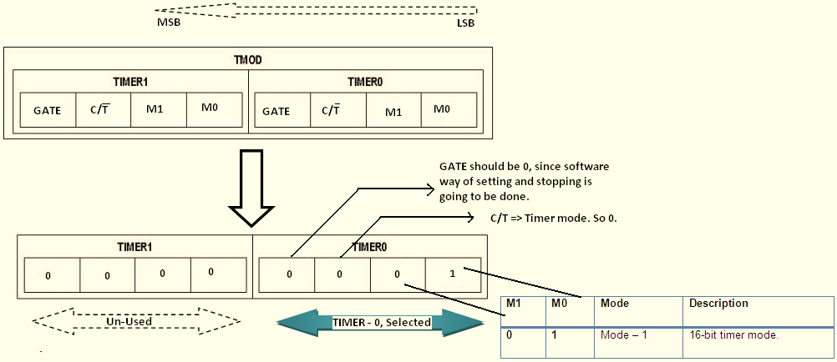
Mode -1 16 bit timer mode
With some value loaded to the timer selected (can be timer 1 or timer 0), one needs to start the timer with the instruction SETB TRx.
X can be timer 1 or 0.
Since it is 16 bit timer one can load values from 0000H to FFFFH, ideally speaking in decimal terms from 0 to 65535.
Well, how to select the timer and mode? Easy.
Step:1 Select timer and timer mode with having TMOD register. Instruction meant for the purpose is MOV TMOD, #01H. // selects timer mode -1 for Timer 0.
What next? The count. Some count that needs to be loaded has to be loaded into TL0 and TH0 since timer 0 is selected the value has to be loaded into TL0 and TH0.

Slide 67
Contd.,
Step: 2 Assuming the value to be loaded is something like FFFEH, using the instructions MOV TL0, #FEH the lower byte of the value FFFEH can be moved.
Then similarly with MOV TH0, #FFH is to be done. Frequency can be varied with the values being loaded into the TH and TL registers and there are few examples with dealing with these in the subsequent topics.
Program should grow like this now:
MOV TMOD, #01H. // selects timer mode -1 for Timer 0.
MOV TL0, #FEH // Lower byte of FFFEH.
MOV TH0, #FFH // Upper byte of FFFEH.

Slide 68
Contd.,
Step : 3. Fine. What next? Start the timer.
For starting the timer SETB TR0, SETB TR1 can be used based on the timer which is being opted.
Once started, it will start moving from ACB1H and will reach 0000H.
Once it is touched, TF (Timer flag) from the TCON register is set, conveying the message that the process is over.
One can monitor the TF with instructions available. And clearly after the process is over one can stop the timer with instruction CLR TR0 or TR1 as depicted already in this same chapter.
Program should grow like this now:
MOV TMOD, #01H. // selects timer mode -1 for Timer 0.
MOV TL0, #FEH // Lower byte of FFFEH.
MOV TH0, #FFH // Upper byte of FFFEH.
SETB TR0 // Timer is started.
LOOP: JNB TF0, LOOP // until roll over, keep doing.
CLR TR0 // Switch it off through instructions.

Slide 69
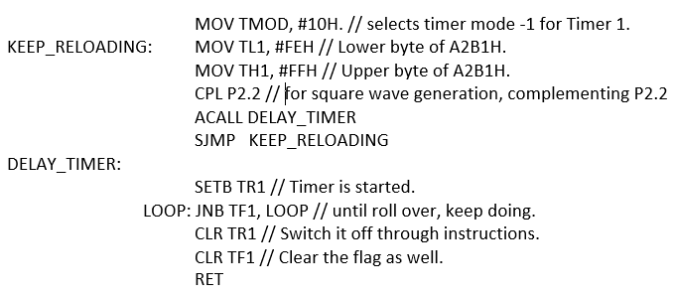
One exercise for you!
Write a simple program to select Mode -1 of timer 1, And after selection, Generate a pulse with having timer 1 used for delay at port 2 bit 2 (P2.2). Value to be loaded into Timer Mode register is FFFEH.

Slide 70
Mode 2 – 8 bit mode
It would allow the user to load the values from 00H to FFH.
One more special feature is it supports auto reload facility.
What is it?
In the other two modes discussed above the user needs to reload the values to start the timer again with the same process.
It can be avoided here. Since there are two registers and one of them (TH) can be loaded with the 8 bit value and a copy can be sent to the other register TL.
So, TH will have a backup of the value that has been loaded into TL
When the timer is started it will move till FF and will roll to 00H.
As usual TF will be set and now the wonder will happen.
The copy of value initially moved to TH will be now moved to TL, this is auto reload and the process will repeat by itself.

Slide 71
Contd.,
MOV TMOD, #20H.
// selects timer mode -2 for Timer 1.
MOV TH1, #08H
// Count to be loaded into TH1, which will copy it into TL1.
SETB TR1 // Timer is started.
LOOP: JNB TF1, LOOP // until roll over, keep doing.
CLR TR1 // Switch it off through instructions.
SJMP LOOP//Auto Reload done.

Slide 72
Mode -3 bit timer mode
This is referred to be Split Timer mode and it is not frequently used one. When Timer 0 is placed in mode 3, it becomes two separate 8-bit timers. Precisely, Timer 0 is TL0 and Timer 1 is TH0. Both these timers will count from 0 to 255 and overflow back to 0. All the bits that are related to Timer 1 will now be tied to TH0.
While Timer 0 is in split mode, the real Timer 1 (i.e. TH1 and TL1) can be put into modes 0, 1 or 2 normally. It is not possible to start or stop the real timer 1 since the bits that do that are now linked to TH0.
Since this mode of operation is not frequently used, not much attention is being paid here.

Slide 73
Welcome to the world of 8051
Shriram K Vasudevan
Session 9

Slide 74
Agenda
Architecture
Features
Family
Pinout
Registers and Organization – A complete understanding.
A and B registers
PSW
Register Bank and Stack (Memory Organization)
Stack Programming
Stack and RB1 clash
8051 and peripherals (i.e. ports)
8051 and Timer
Magic Number – 11.0592
TCON and Counter Operations
8051 and interrupts.
RS 232 – Serial Communication

Slide 75
Contd.,
Every clock needs source for pulse.
8051 has the crystal frequency of 11.0592 MHZ supported mostly.
Though there is a room for having a range of frequency up to 40 MHZ.
Why is it so? Is there a secret behind? Nope.
Simple answer, With this frequency interfacing with IBM PCs and establishing communication is much easier. So it has been selected to be the most commonly used one.

Slide 76
Contd.,
Well, When 11.0592 is the clock frequency what would be the time period and frequency obtained?
Straightforward formulas are available and are going to be deployed here.
Frequency of the timer = 1/12th (Frequency of crystal being used)
So here, Frequency of the timer = 1/12th (11.0952 MHz)
= 924.6 KHz
Time period = 1/Frequency of timer
= 1/924.6 KHz
= 1.0815 µsec.

Slide 77
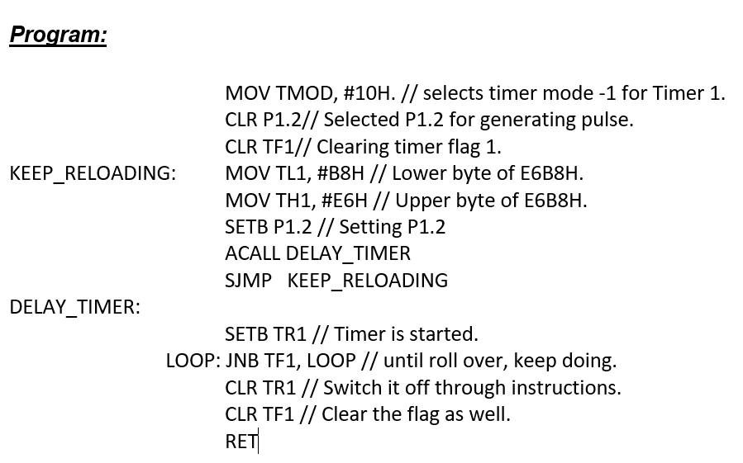
Contd.,

Slide 78
Contd.,

Slide 79
Welcome to the world of 8051
Shriram K Vasudevan
Session 10

Slide 80
Agenda
Architecture
Features
Family
Pinout
Registers and Organization – A complete understanding.
A and B registers
PSW
Register Bank and Stack (Memory Organization)
Stack Programming
Stack and RB1 clash
8051 and peripherals (i.e. ports)
8051 and Timer
Magic Number – 11.0592
TCON and Counter Operations
8051 and interrupts.
RS 232 – Serial Communication

Slide 81
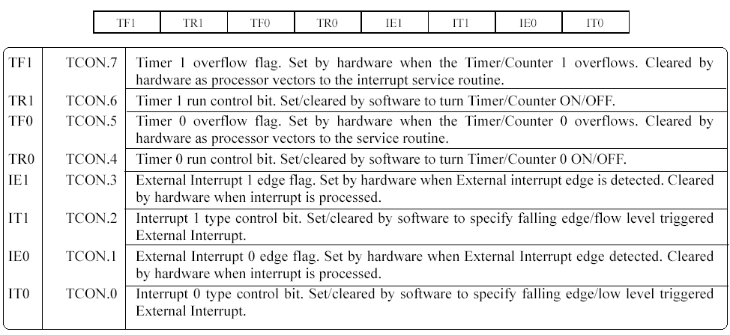
TCON Register (This is an SFR)
TCON is Timer control register and it is one of the most important SFRs.
TF0, TR0, TF1, TR1 have been frequently used in the discussions on timer programming, they all come from here.
All the bits are bit addressable.
SETB TR0, CLR TR0 are few instructions with which programmers can access the bits.

Slide 82
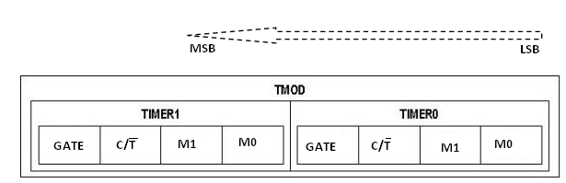
8051 and the counter saga!
Timers can also be used to count events.
Simple example could be, a sensor can be placed across the motor cycle production units.
It will pulse when a motor cycle comes out of the production unit.
This will help in counting the number of units manufactured in a day.
Everything is same except the C/T.
Since counter has to be selected, it is mandatory for the programmer to set 1 in that slot. If set so, timer can be made to function as a counter.

Slide 83
Contd.,
If C/T = 1, then timer is used as a counter and gets its pulses from outside the chip.
The counter counts up as pulses are fed from pins 14 and 15, these pins are called T0 (timer 0 input) and T1 (timer 1 input).

Slide 84
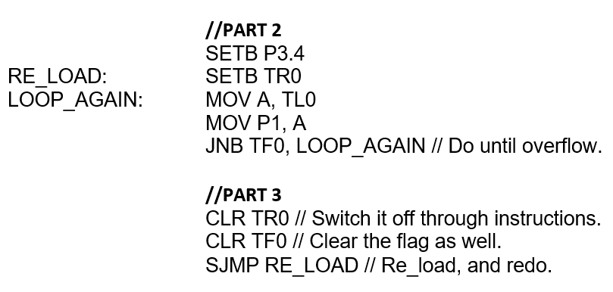
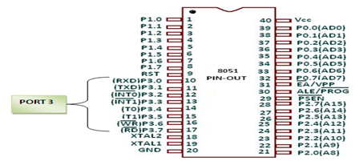
An example.
A program for receiving input from Port 3 through T0 and passing the count on to different port is performed in the following code.
Part – 1: Selection of Counter – 0 and mode 2. It is done with the three instructions presented. //PART 1
MOV TMOD, #06H. // Selects Counter0 from C/T and Mode 2.
CLR TH0
CLR TL0 // Clearing both the registers.
Part – 2: Well, Here pulses are sent via T0, which is part of PORT 3 and represented by P3.4. It is set as input port through the code. Starting the timer/counter is done via SETB TR0. Then the data (i.e. count) is received from TL0 and sent to Accumulator to send it through another port. Here Port P1 is selected. I.e. count is received from port 3 and sent to port 1.

Slide 85
Welcome to the world of 8051
Shriram K Vasudevan
Session 11

Slide 86
Agenda
Architecture
Features
Family
Pinout
Registers and Organization – A complete understanding.
A and B registers
PSW
Register Bank and Stack (Memory Organization)
Stack Programming
Stack and RB1 clash
8051 and peripherals (i.e. ports)
8051 and Timer
Magic Number – 11.0592
TCON and Counter Operations
8051 and interrupts.
RS 232 – Serial Communication

Slide 87
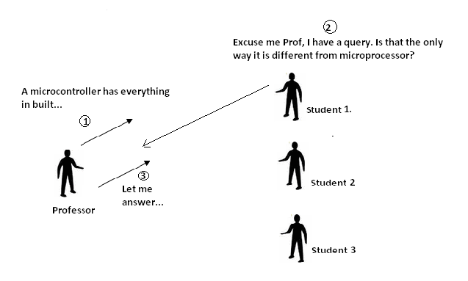
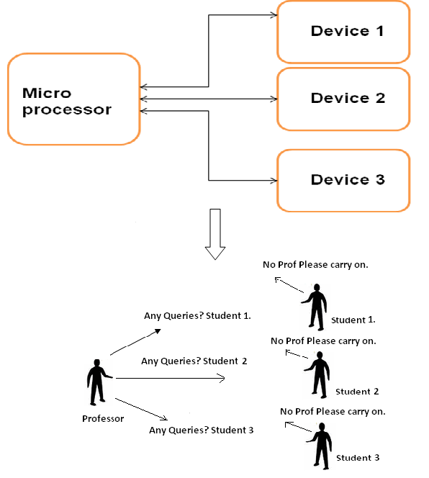
Polling or Interrupt
Polling
Interrupt

Slide 88
What happens when an interrupt is raised?
An interrupt is just like subroutine name.
When called it should go and pull out corresponding piece of code which will do the function. It is referred to be as Interrupt Service Routine.
In Linux it is referred to be as signal handler.
Assuming the microcontroller is executing one instruction and at the middle of it, an interrupt is getting raised, what will be the right thing to do?
Microcontroller should complete the current execution and then it can move to the interrupt which is being raised.
Microcontroller will complete the execution of current instruction and will look for address of next instruction to be executed and will store it in the Program Counter register (PC).
Next point, where will the interrupt service routing be stored? Which address will be used for the storage? Every interrupt service routine has an address and that detail is stored in a table. It is referred to be as interrupt vector table. The interrupt vector table will hold address of all the ISRs for the interrupts

Slide 89
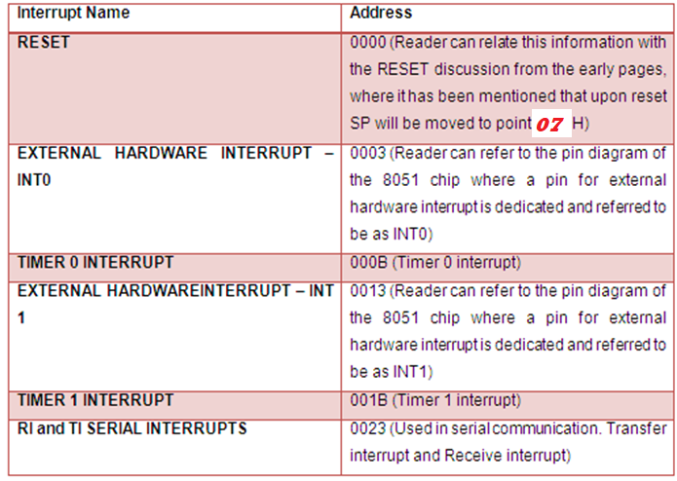
ISR – Interrupt Service Routine

Slide 90
Contd.,
Once the address is found microcontroller will move on there and will execute the interrupt service routine, i.e. will respect the interrupt request. After the work is over, RETI is the instruction used and it will help in returning back from the interrupt to the place from where it started.
Since the address has been already backed up in the stack, Microcontroller will fetch that address from there and can continue the work that it had been doing.

Slide 91
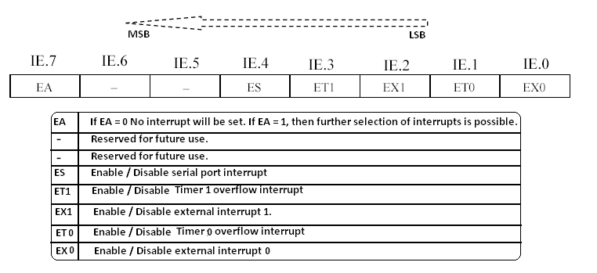
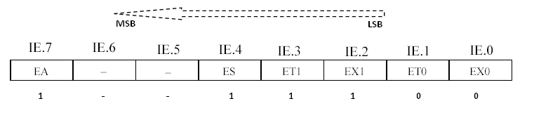
IE (Interrupt Enable SFR)
If someone wants any of the interrupts in the IE register to be used, first EA should be set to 1. Means D7th bit (IE.7) should be set to 1 which will allow the programmer to enable other interrupts present in the register
This above shown values for IE register in figure will enable:
EA =1, so IE will be usable.
ES=1, Serial interrupt is set
ET1=1, Timer 1 interrupt is set.
EX1 =1, External interrupt1 is set.
With all these, MOV IE, #10011100B can be used to set the desired interrupts.

Slide 92
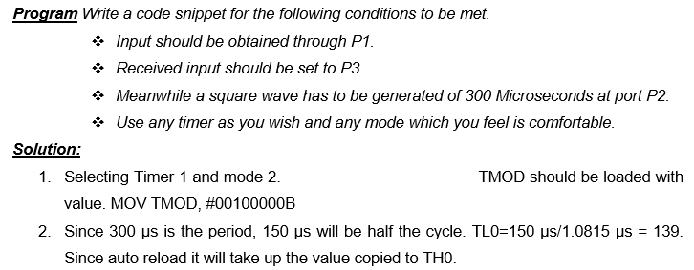
A Program

Slide 93
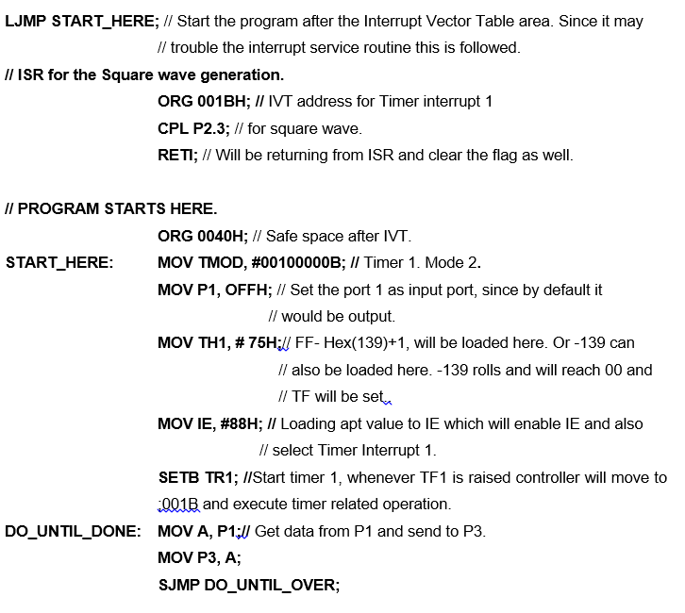
Code…

Slide 94
Welcome to the world of 8051
Shriram K Vasudevan
Session 12

Slide 95
Agenda
Architecture
Features
Family
Pinout
Registers and Organization – A complete understanding.
A and B registers
PSW
Register Bank and Stack (Memory Organization)
Stack Programming
Stack and RB1 clash
8051 and peripherals (i.e. ports)
8051 and Timer
Magic Number – 11.0592
TCON and Counter Operations
8051 and interrupts.
RS 232 – Serial Communication

Slide 96
Recommended Standard 232 C
RS-232C, EIA RS-232, or simply RS-232, refers to the same standard defined by the Electronic Industries Association in 1969 for serial communication.
The RS-232 serial interface was developed for connecting a computer to common peripherals such as modems, overhead projectors, and the sensors and actuators used for industrial automation applications.
Despite its limited 15 m transmission distance, RS-232 is low cost and easy-to-wire, making it the first choice for many applications.
RS-232 C is a serial interface standard defined by Electronic Industries Association in 1969.
RS stands for recommended standard, C stands for version.

Slide 97
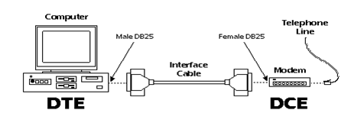
RS 232 Terminologies
To get a better understanding of RS-232, one should first know on few terminologies. They are
DTE (Data Terminal Equipment) and
DCE (Data Communication Equipment)
So, what is what is the next question. Assume a computer connected to a Modem.
There Computer is referred as DTE which transmits and receives the data. Modem is the DCE, which facilitates that data transfer.

Slide 98
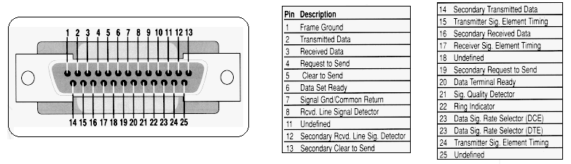
Contd.,
Originally or traditionally there were 25 Pins in the RS 232 and currently only 9 pins are used.
Former is named as DB 25 connector and the latter is called as DB 9 connector.
Since DB 25 is almost obsolete, DB 9 signaling is explained in detail.
DB 9 connector is the most commonly used and it has only 9 pins out of 25 pins from DB 25 connector.
In short it can be called as simplified version of DB 25 connector

Slide 99
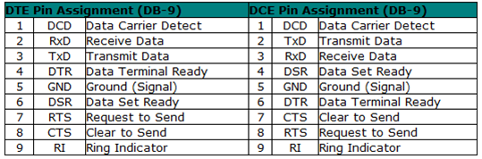
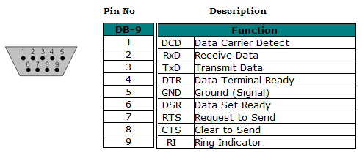
Contd.,

Slide 100
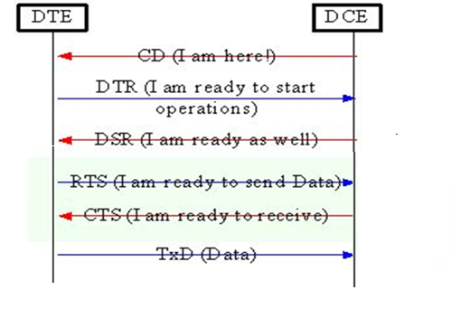
Signals for DB9 have to be learnt in clear in order to understand the interface.
DCD – Data Carrier Detect – It is a signal triggered by Modem (DCE) to PC (DTE), stating that the connection has been established between the DCE and DTE.
RxD - Receive Data – Transmission of data will happen with this signal.
TxD – Transmit Data – As name indicated, receive action will happen with this signal.
DTR – Data Terminal Ready – When the DTE is turned on, it has to indicate that it is ready for the communication. DTR is the signal to indicate that the DTE is on and it is ready of the communication. This will be acting as intimation for the DCE. And in case of a problem with the DTE this signal would not be triggered and it can act as an alarm and the problem can be found out.
Ground – The common ground for establishing proper grounding.
DSR – Data Set Ready – And it is just like DTR. But this signal is triggered from DCE. As mentioned already it is nothing other than modem. It is fed to DTE and it will inform DTE that DCE is ready for communication.
RTS – Request To Send – When some data has to be sent from DTE to DCE, RTS will be sent and it will inform DCE that some data is about to be sent and it has to be ready to receive the same. DTE here raises a request to the DCE to be prepared to receive the data.
CTS – Clear To Send – When the RTS is received, if the DCE has got enough space to have the data received from DTE and to store it. it will send CTS (Clear to send) to make DTE understand that, data transmission can be started. It will serve as an input to DTE from DCE. It says that it is ready to accept the data.
RI – Ring Indicator – It is an output from modem and it serves as an input to the PC which serves as an indication for telephone ring. It will go on and off with ringing sound accordingly.

Slide 101
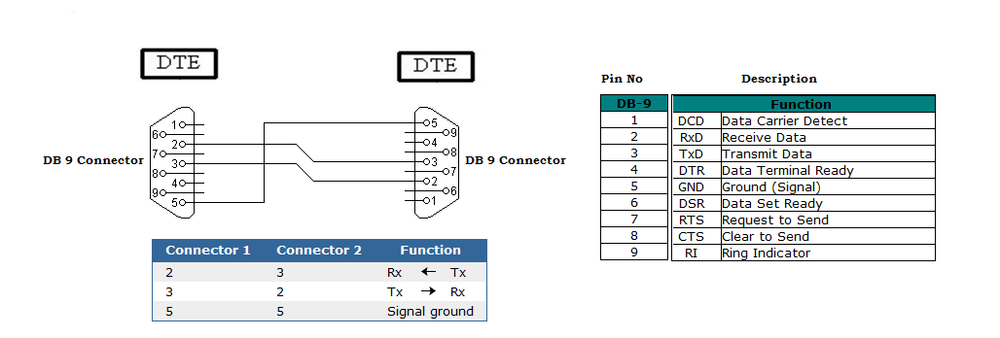
Null Modem Configuration
The purpose of a null-modem cable is to permit two RS-232 "DTE" devices to communicate with each other without modems or other communication devices (i.e., "DCE"s) between them.
To achieve this, the most obvious connection is that the TD signal of one device must be connected to the RD input of the other device (and vice versa).

Slide 102
Welcome to the world of 8051
Shriram K Vasudevan
Session 12

Slide 103
Agenda
Architecture
Features
Family
Pinout
Registers and Organization – A complete understanding.
A and B registers
PSW
Register Bank and Stack (Memory Organization)
Stack Programming
Stack and RB1 clash
8051 and peripherals (i.e. ports)
8051 and Timer
Magic Number – 11.0592
TCON and Counter Operations
8051 and interrupts.
RS 232 – Serial Communication

Slide 104
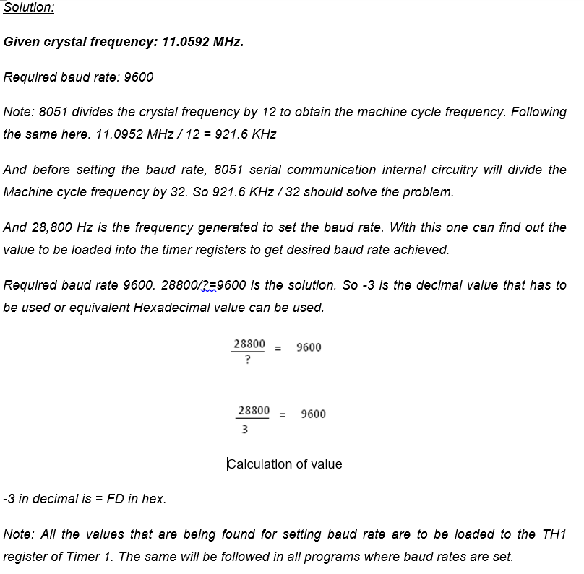
Serial communication programming with 8051
“The baud rate is the rate used for the communication purpose and it is used to identify that how much of the data had been transferred but at how much speed.”
The permissible and allowed baud rates are varying the range and very frequently used baud rates are to be taken into consideration here. 9600 is the most frequently used baud rate

Slide 105

Serial Programming – Steps

Slide 106
Contd.,
One more important thing to note has to be mentioned.
SBUF is a serial communication buffer which is used specially for serial communication operations done with 8051.
For both transfer of data and receive action of date SBUF is the boss.
Data when transferred will be sent via this with adding Start and Stop bits and when receiving it will unpack the data by removing Start and Stop bits.

Slide 107



Slide 108
Thank You!
Shriram K Vasudevan
Meet you soon with programming exercises and instruction set details

